Slide 1
Spring + JDBC example
Employee table
In this example, we are using MySQL database.
CREATE TABLE `employee` (
`EMPLOYEE_ID` int(10) unsigned NOT NULL AUTO_INCREMENT,
`NAME` varchar(100) NOT NULL,
`AGE` int(10) NOT NULL,
`SALARY` int(10) DEFAULT NULL,
PRIMARY KEY (`EMPLOYEE_ID`)
) ENGINE=InnoDB AUTO_INCREMENT=4 DEFAULT CHARSET=utf8

Slide 2
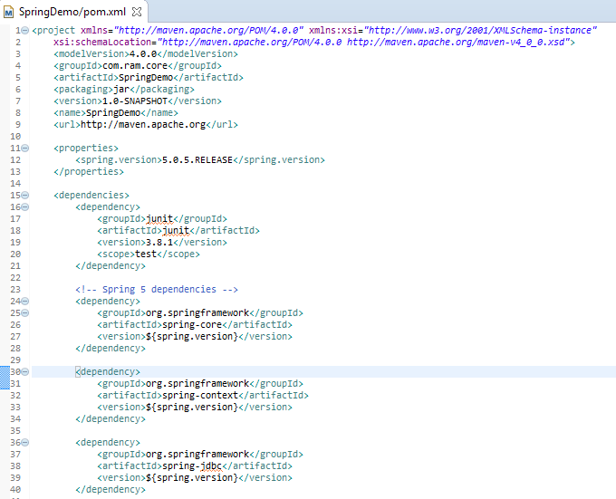
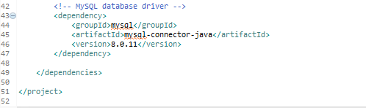
Spring + JDBC example
Add Spring and MySQL dependencies

Slide 3
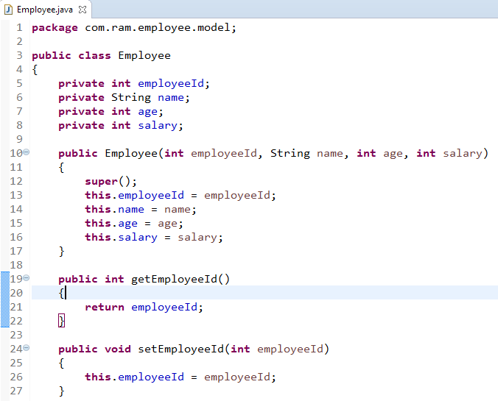
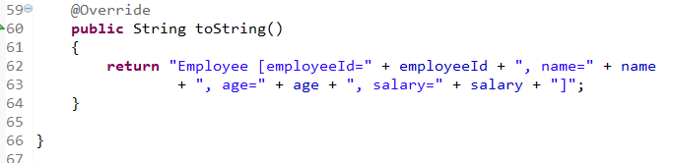
Spring + JDBC example
…….
…….

Slide 4
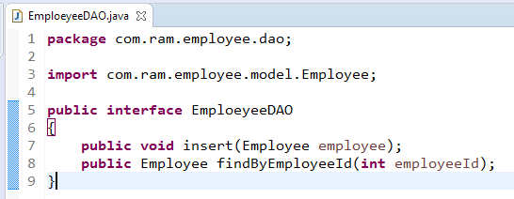
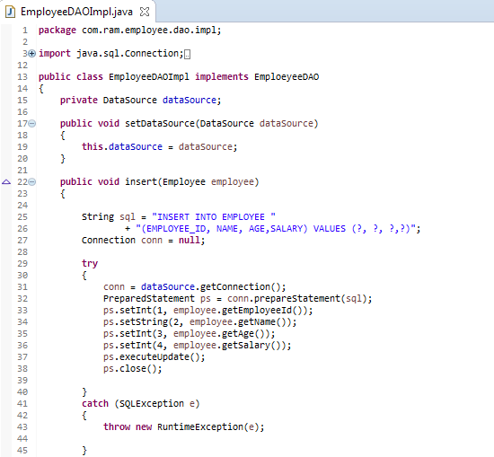
Spring + JDBC example

Slide 5
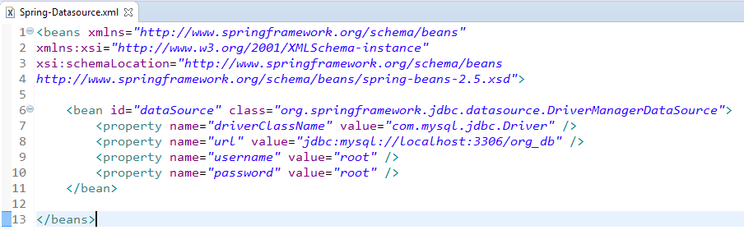
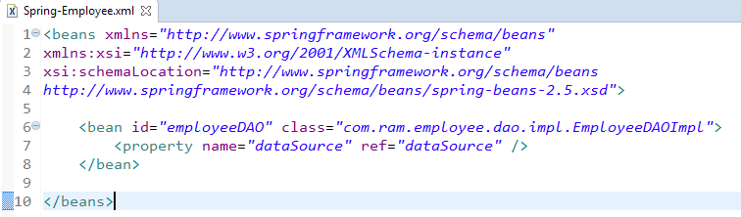
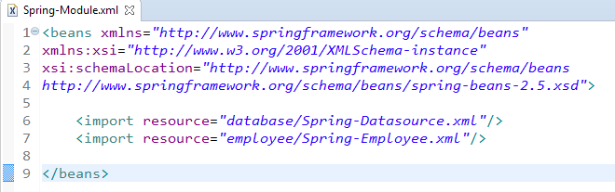
Spring + JDBC example

Slide 6
Spring + JDBC example
Dir stru

Slide 7
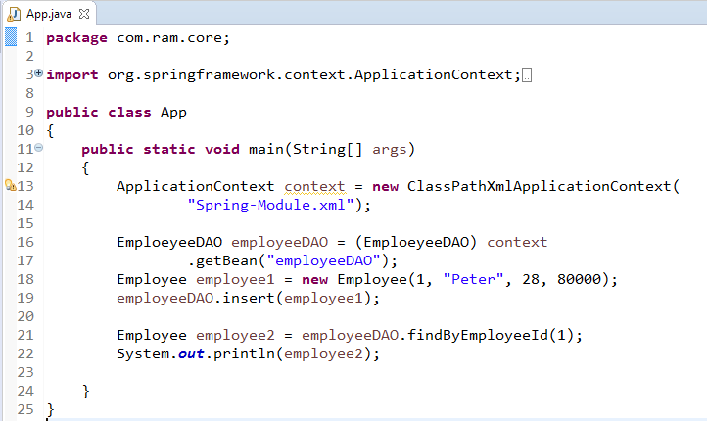
Spring + JDBC example

Slide 8
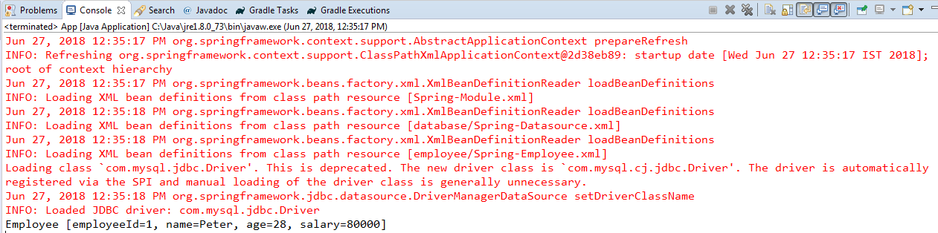
Spring + JDBC example

